Slide 1


EDA 3 – Group 3

Slide 2


Slide 3
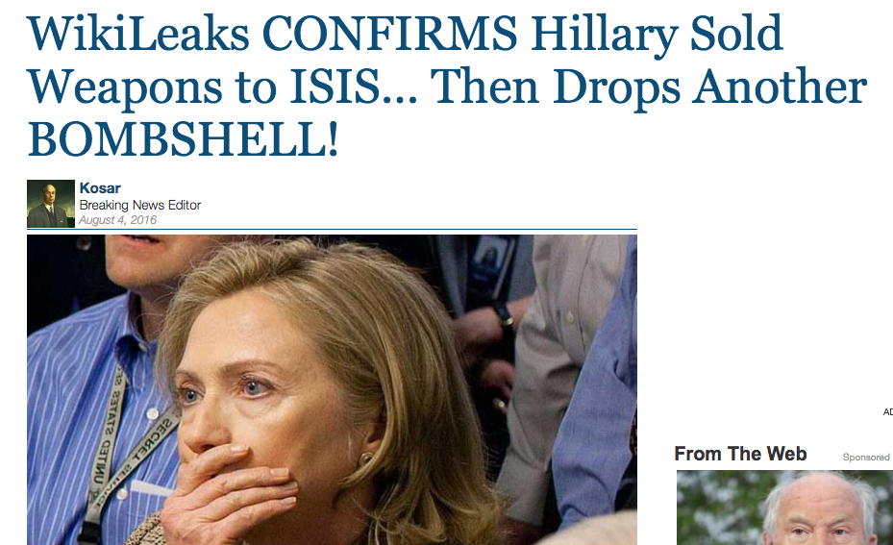

Slide 4
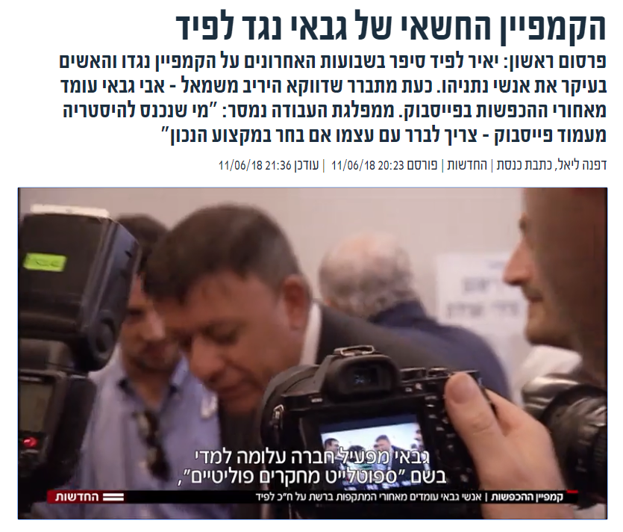

Slide 5
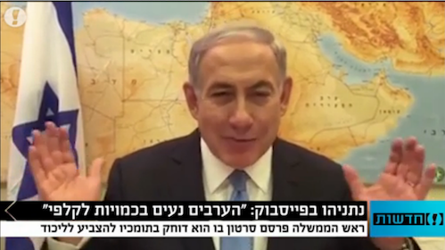

Slide 6


Slide 7
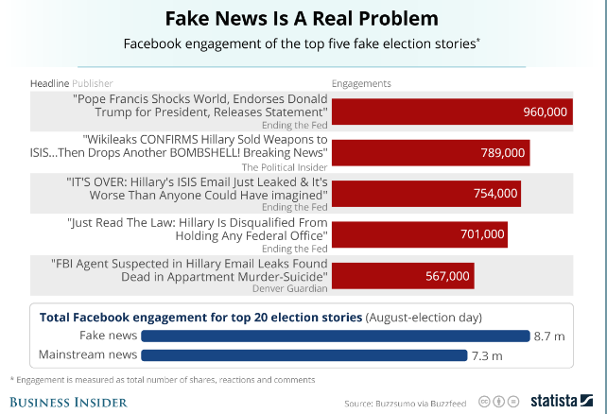
Shares, reactions and comments on Facebook

Slide 8
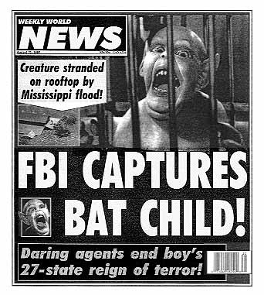
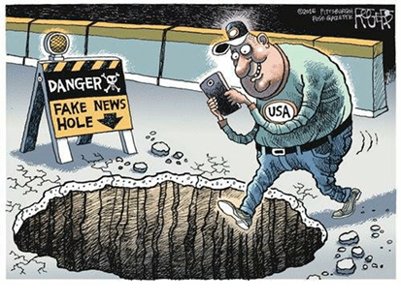
People are not very good in spotting fake news

Slide 9
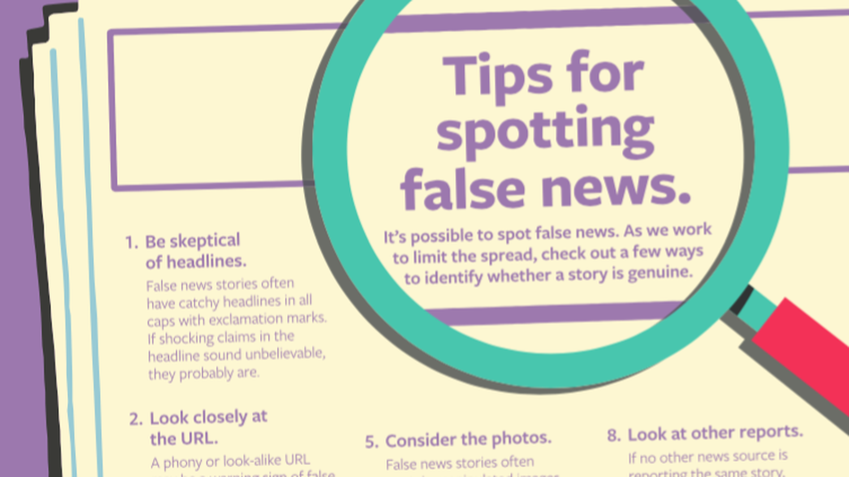
This doesn’t help much…

Slide 10
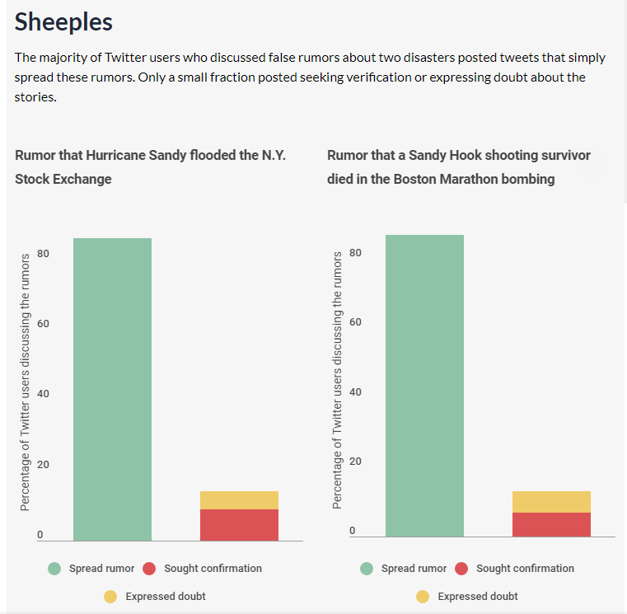
Because people don’t seek confirmation for stories

Slide 11
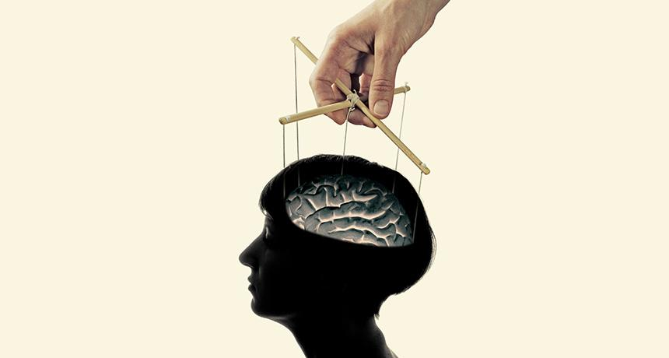
and are to easy to manipulate in the digital era

Slide 12
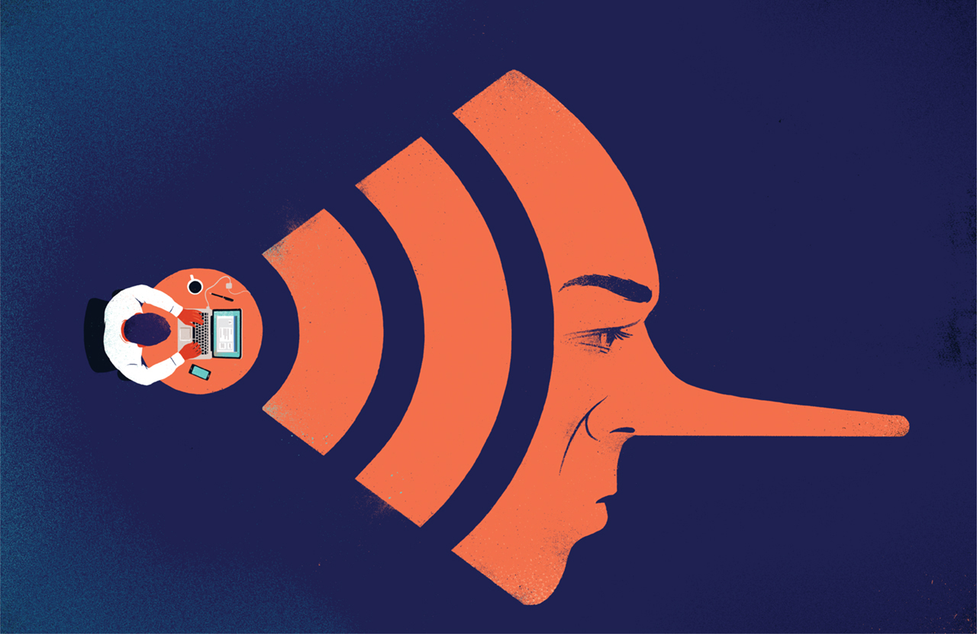
Fake news evolved into a profession that enjoys the use of many efficient tools and budgets

Slide 13
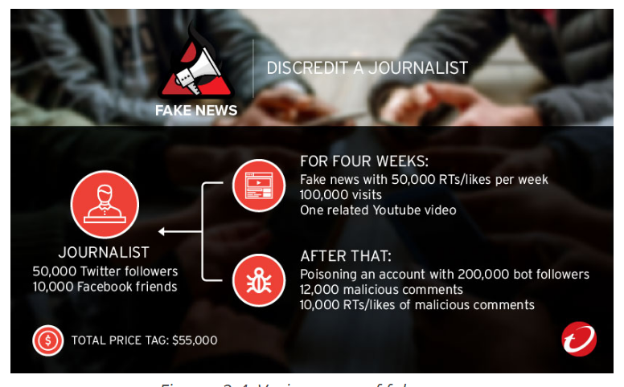

Slide 14


Slide 15
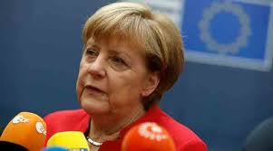
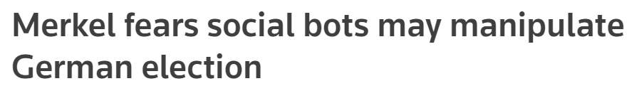

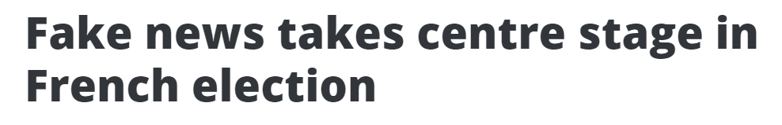
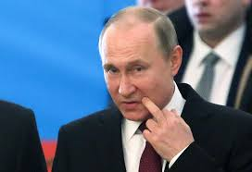
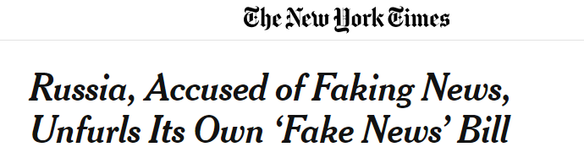

Slide 16


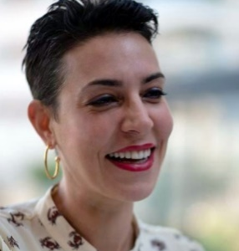

FakeWatch
https://github.com/shtayeromri/FakeNews
Yoav Ast
COO Product Manager
Yael Szafran CMO Planning and story telling
Omri Stayer CTO
Developer

Slide 17
Our vision
Real-time Fake News detection
Protecting Our Society
from manipulation using machine learning algorithms to detect news and news site that are fake!

Slide 18
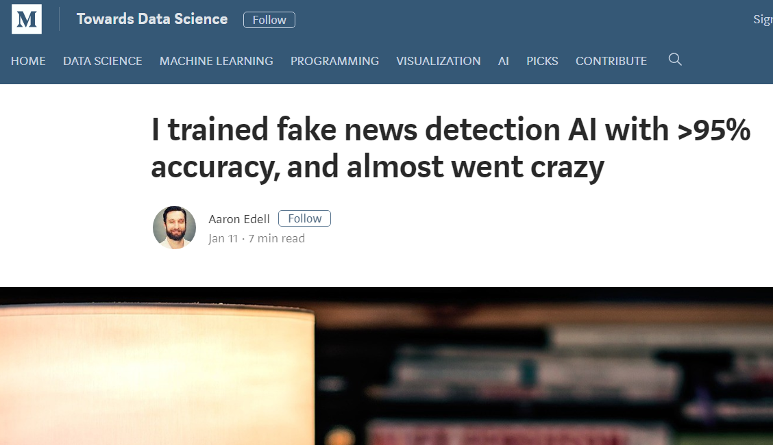
Prior work

Slide 19
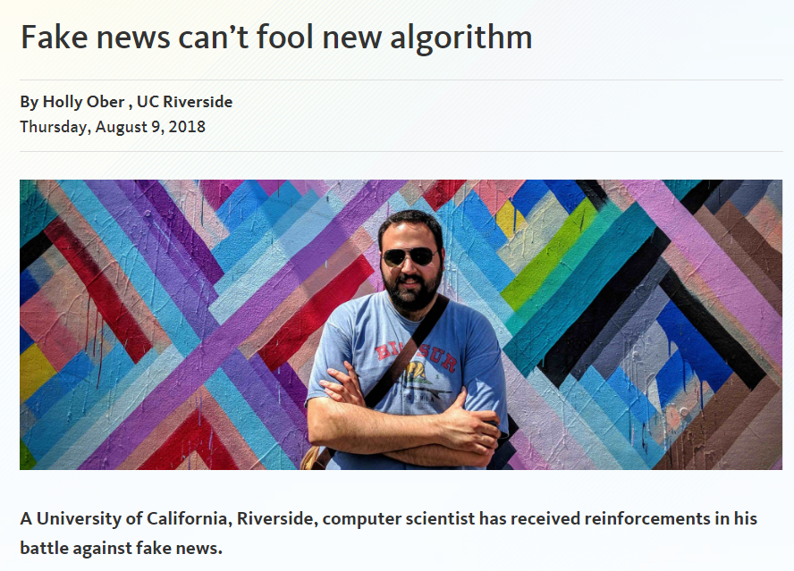

Slide 20


Slide 21
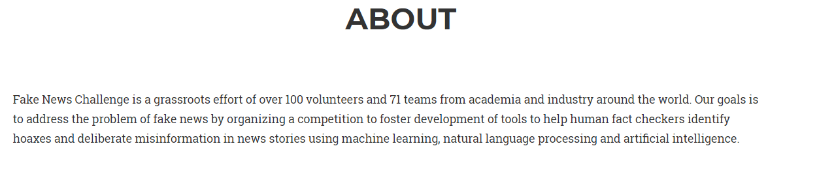


Slide 22
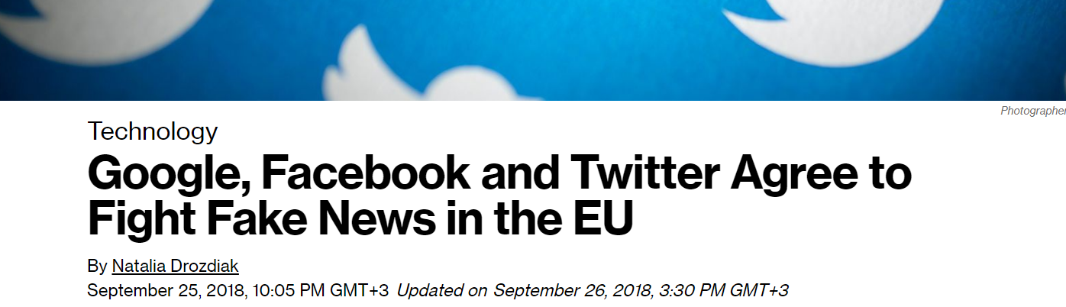
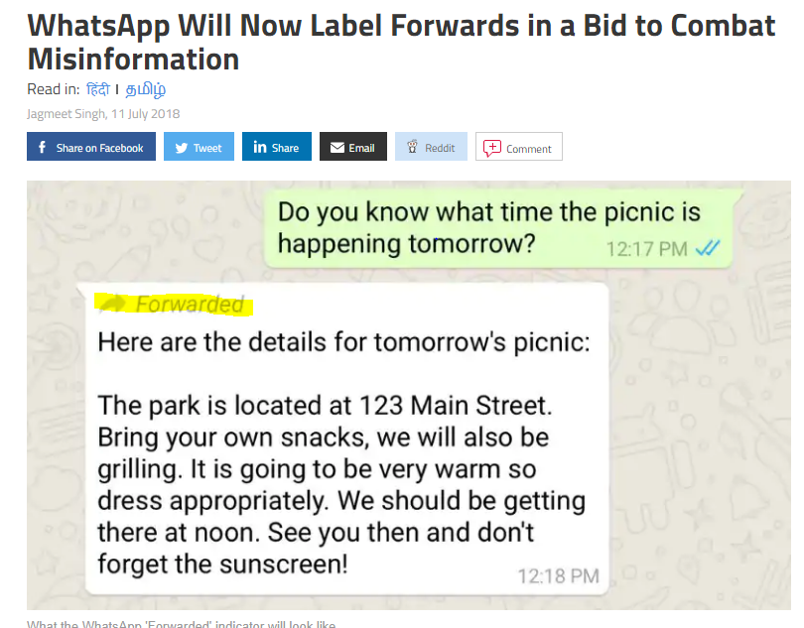

Slide 23
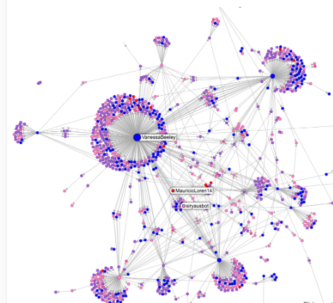

The Business
Website – The FakeWatch barometer. Online live warnings about new fake headlines.
(Fake news travel 6 times faster then the truth)
Site Grading Algorithm
Chrome Extension– Fake detector, the FakeWatch Alarm

Slide 24

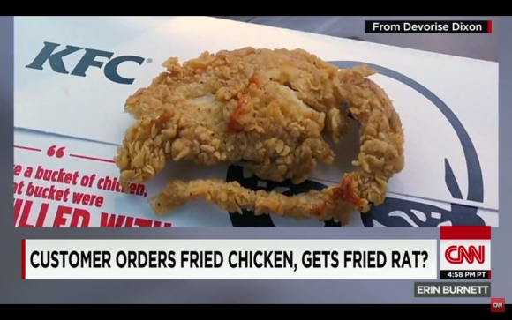


בעלי עניין
Who might be interested in using this kind of protective technology?
Private
Corporate Reputation attacks
Gov
Public opinion manipulation, antisemitism and terror
Social
Fact checkers and people who care about democracy

Slide 25
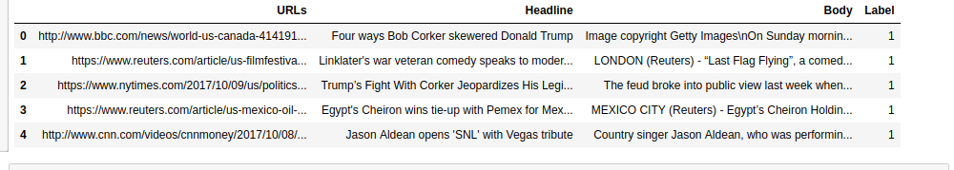
Our raw data

Slide 26
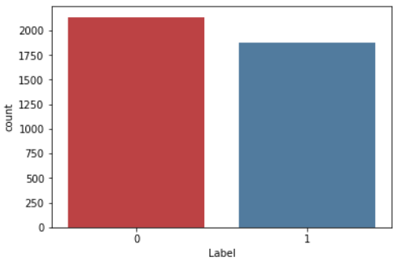
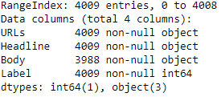
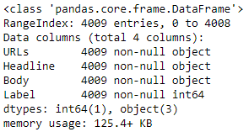
Among 4009 News Articles
2137
1872
Body Null Values to “NO”
Fake – 53.3%
Real – 46.7%

Slide 27
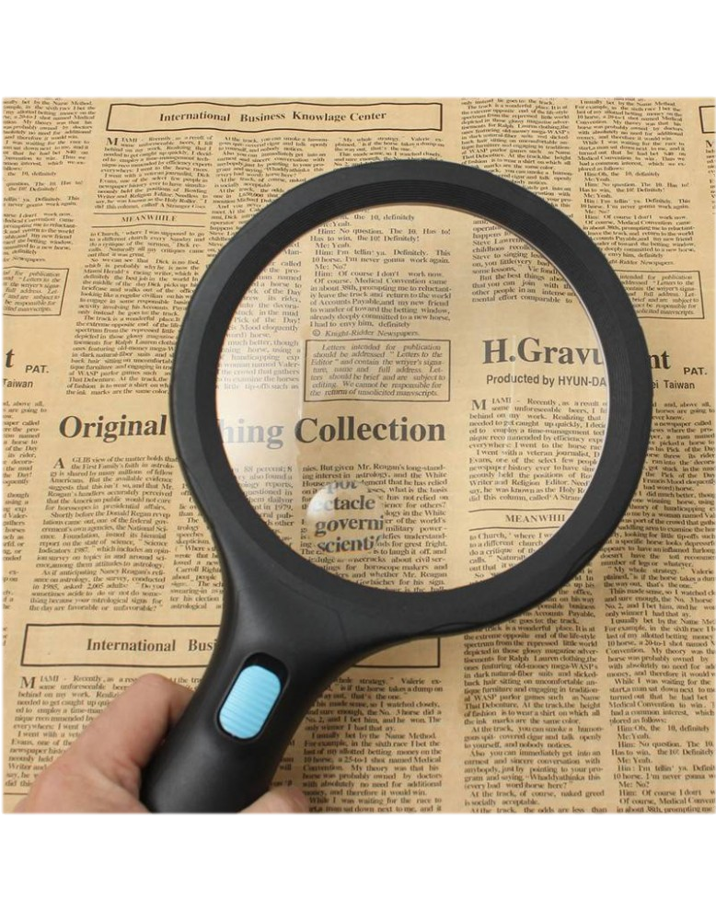
What we did?
Using “No body” rows
Categorizing the sites
Adding Frequently used words Columns
Adding Frequently used Text to Columns
Head & Body Length
Using Adaptive algorithm to add new words to frequently used words

Slide 28
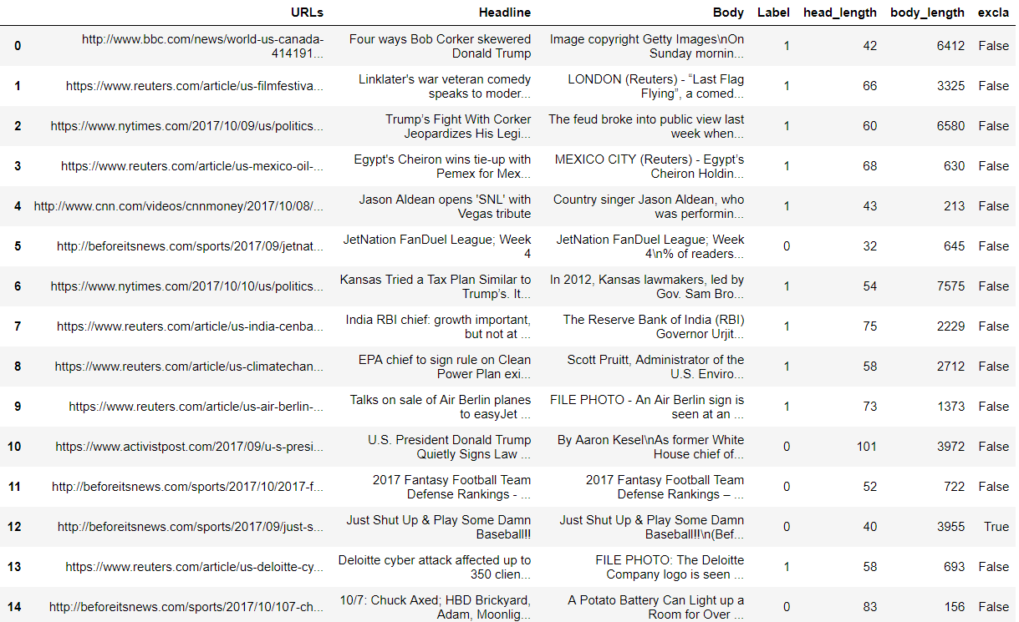
Our Data
Enriching our Data
URL - Site
Headline
Body
Fake?
(0=y, 1=n)
Head&Body Length
“!” in Head

Slide 29
What have we found

Slide 30
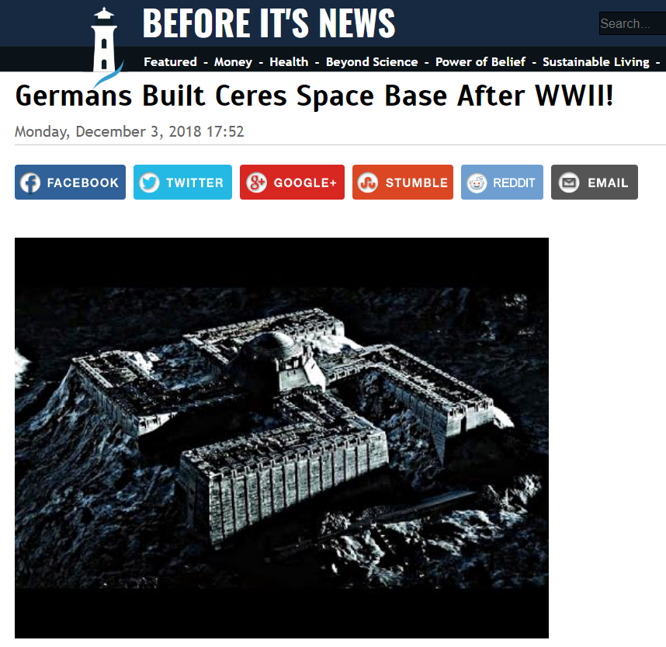
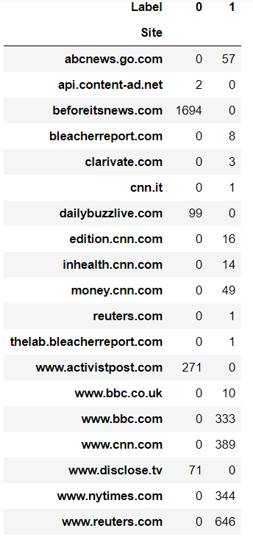
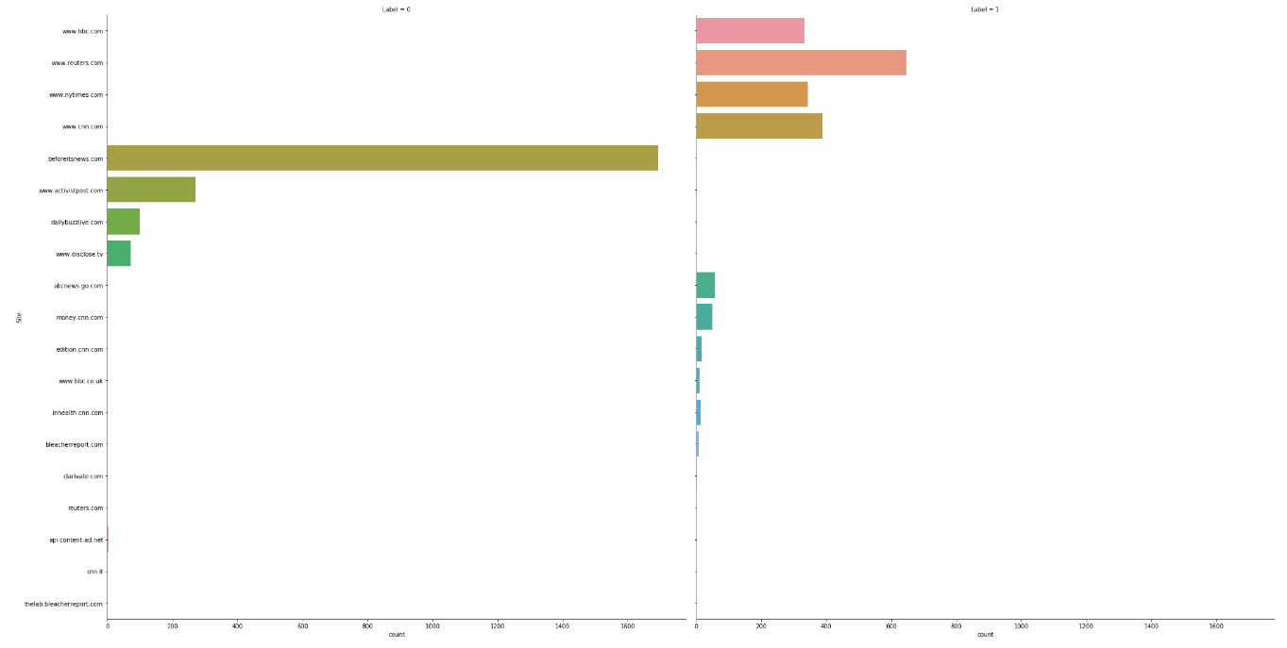
A site is fake or not?
Site Credibility

Slide 31
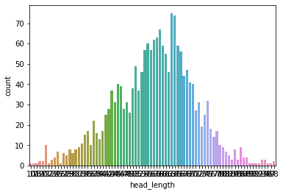
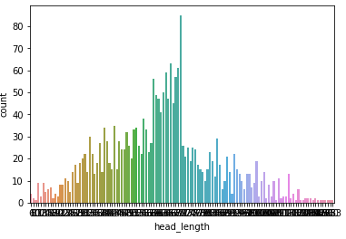
Body length
Fake News have shorter body text
AVG 3554 words
AVG 2375 words

Slide 32
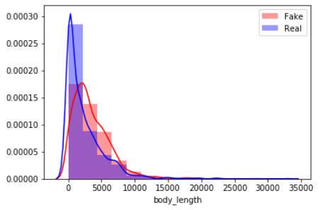
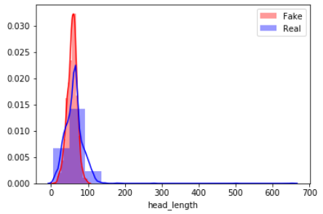
Head & Body Length
Header & Body Length
Body Length
Head Length

Slide 33
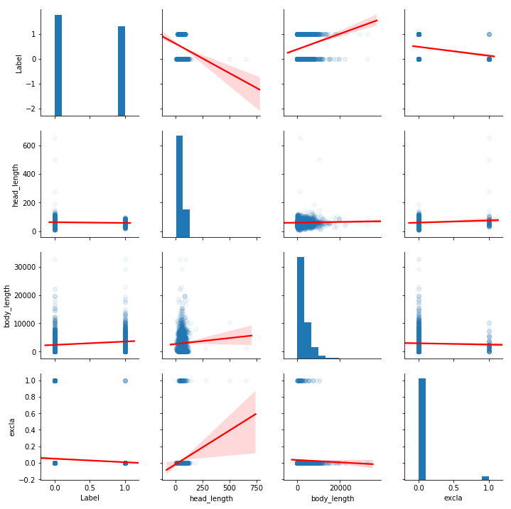
Predicting Fake News
Excla in Head ~ Fake news
Long body text ~ Real news
Longer Header ~ Fake news

Slide 34
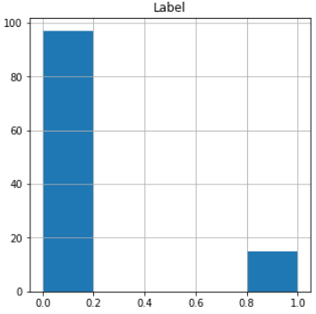
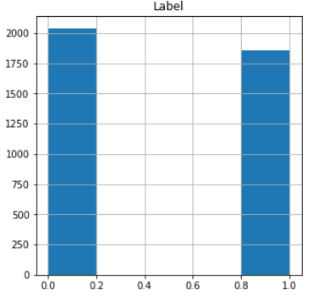
“!” in Header
Without “!” in Text
With “!” in Text
Header Without ”!”
Header With ”!”
87% Fake

Slide 35
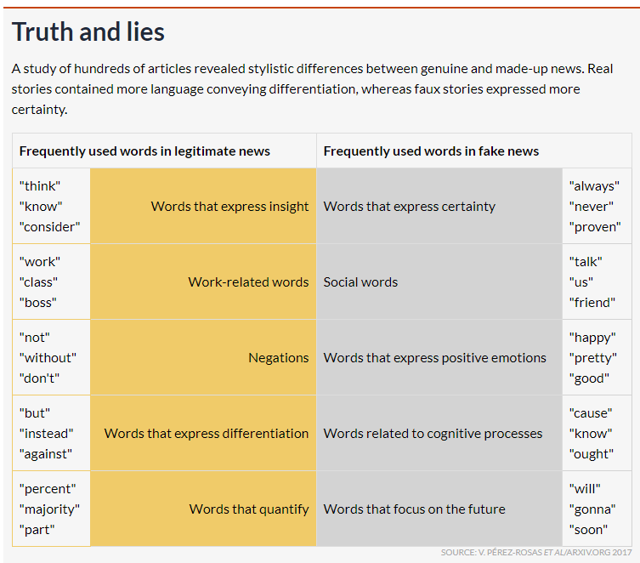
More Parameters that will be tested

Slide 36
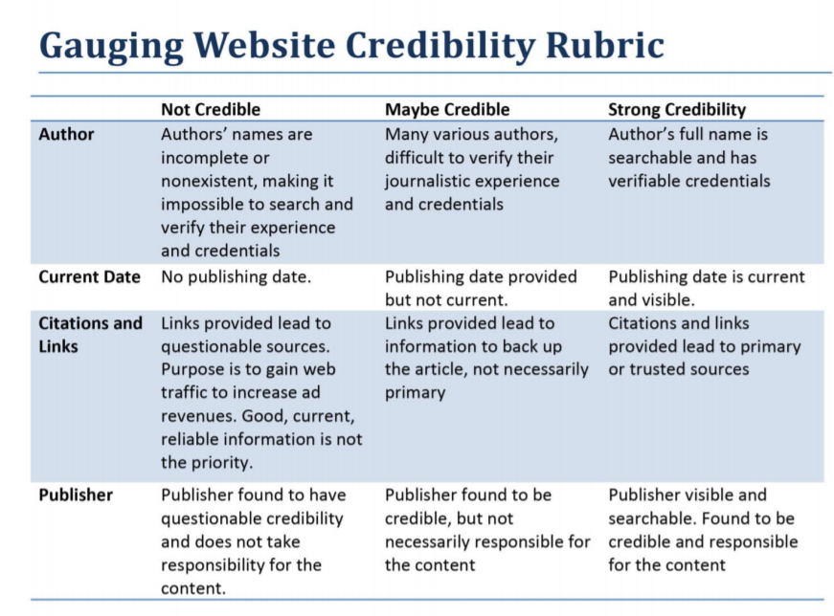

Slide 37
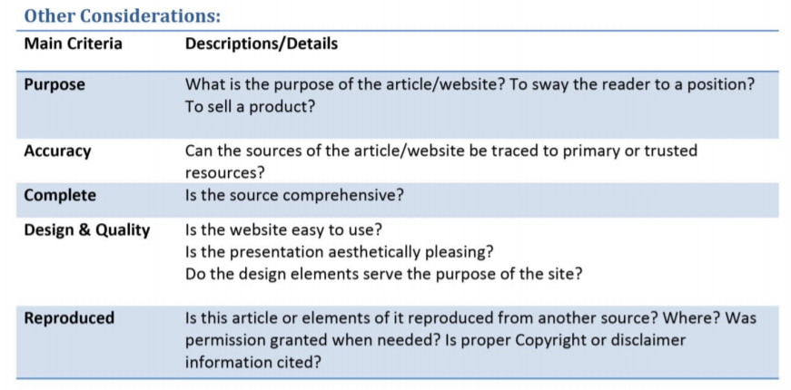

Slide 38
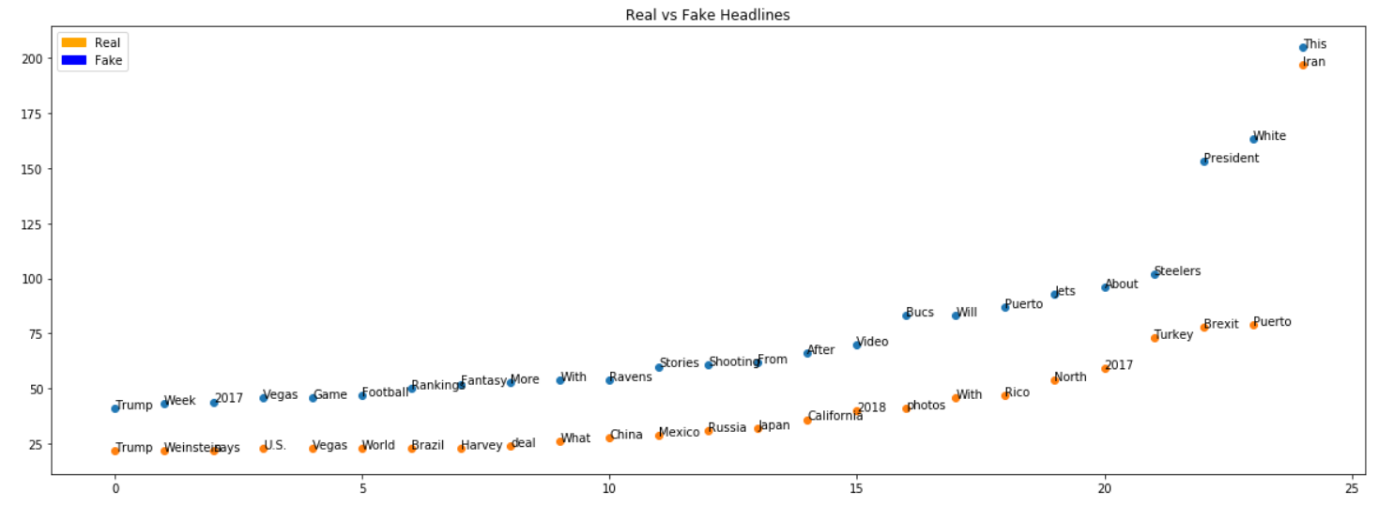
Frequently Used Words

Slide 39
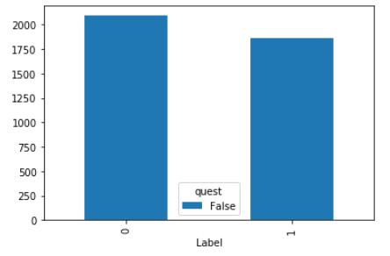
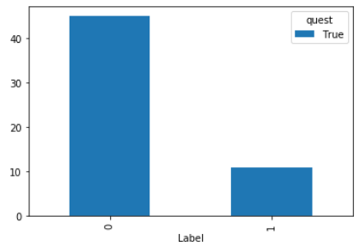
Frequently Used Words
“President” in the beginning of heading
80% Fake
Fake
Real
Fake
Real
Without President
With President

Slide 40
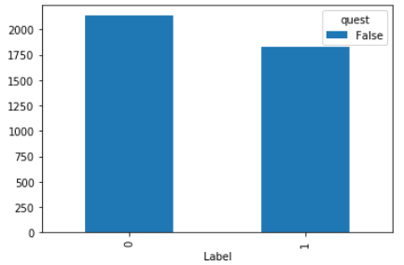
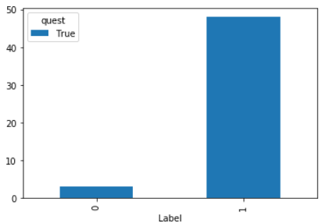
Frequently Used Words
“new” in the heading
94% Real
Fake
Real
Fake
Real
Without “new”
With “new”

Slide 41

DATA
bases

Slide 42

Thank You

